Slide 1
A TPC Benchmark for EII Servers
Dina Bitton
CALLIXA

Slide 2





An EII (Enterprise Information Integration) Platform
To a Business end-user, an application developer, or an application program, the enterprise data sources appear to be a single, integrated, relational database.
VIRTUAL
DATABASE
SCHEMA
VIRTUAL
CUSTOMER
TABLE
VIRTUAL
TRADES
TABLE
VIRTUAL
ACCOUNTS
TABLE
VIRTUAL
CREDIT
TABLE
EII SERVER
ORACLE
ORACLE
XML

Slide 3
LET THE RACE BEGIN!
IBM Information Integrator
Oracle Data Hub
Callixa, Composite Software, Metamatrix
Benchmark wars anyone?

Slide 4
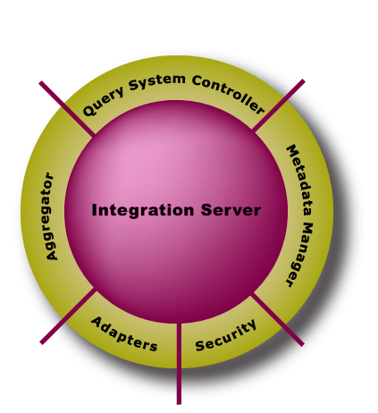
Benchmarking an EII Server
Strong
model, unify and deliver information from across the enterprise, irrespective of data type, ownership or location.
ETL
Federated Functionality
Server must provide:
Dynamic integration (not copy the data)
Shared-nothing Parallelism
Load Balancing & High Availability
Non-intrusive operation
DB Gateways
Weak
Performance / Scalability
Strong

Slide 5
Modeling EII Capabilities
Ability to model a virtual database defined by “federating” heterogeneous databases
Federation primitives to be modeled:
  Distributed, heterogeneous environment
  Metadata:
    Data transforms
    Replication
    Fragmentation

Slide 6



Integration Server Architecture
Client 1
Client 2
Client 3
Client 5
Client 4
HUB 1
HUB 2
HUB 3
Data Agent 1
Data Agent 2
Data Agent 3
Data Agent 4
Data Agent 5
Shared-nothing Distributed Architecture for Performance, Scalability, and High Availability
Process intercommunication - process-to-process socket communication
Multithreading
Pipelining
Notes:
Multiple query servers provide scalable capacity for multiple users
Multi-threading query servers and data agents deploy parallel pipelines to process multiple concurrently running queries
Processing is distributed across query servers and data agents to enable optimal use of hardware resources
Database servers do as much of the work as possible
A query server is a single process on its host machine, uses multiple threads to handle requests from multiple users
Add query servers to spread user load across more processes
Multiple query servers can be on one machine or many
Each Data Agent is a single process on its host machine, creating threads as needed to handle all requests from Query Servers and other Data Agents
In handling one query request, a Query Server will make multiple requests to multiple Data Agents
Parallel processing: all the Data Agents are running threads simultaneously, a Query Server directs the gathering and consolidation, then returns results
Query Servers do all the analysis and organizational processing of queries, all the heavy lifting (of manipulate the actual data) is directed by Data Agents. As much of it is performed in the data servers as possible. Data servers are most efficient in handling volumes of data from many users.

Slide 7
A TPC Benchmark for EII
Test database: federation of 3 TPC-D test databases distributed across Oracle, UDB and MS SQL Server
    Schema translation/Data transformation
    Replication
    Fragmentation
17 TPC-H queries including
  Single table with fragment elimination
  Single table with multiple fragments needed + Aggregate functions
  Simple cross-join with two single site tables More complicated cross-join with all 3 fragments join without filtering to a single site table (large volume data shipping)
  A 4-way join involving (Master/Detail) fragmented tables, a single-site table, and a replicate (or redundant) table

Slide 8
3-Site Integration Server Deployment
4 CPU, 2 GB RAM
Solaris 2.7
Callixa
Client
Callixa
Client
Query
Server
4 CPU, 3 GB RAM
AIX 4.3.3
4 CPU, 3 GB RAM
Solaris 2.8
4 CPU, 3 GB RAM
Solaris 2.8
Data
Agent
Data
Agent
Data
Agent
Data
Agent
UDB 7.2
X GB TPCD
Sybase 12.0
X GB TPCD
Oracle 8.1.7
X GB TPCD
Site 1
Site 2
Site 3

Slide 9
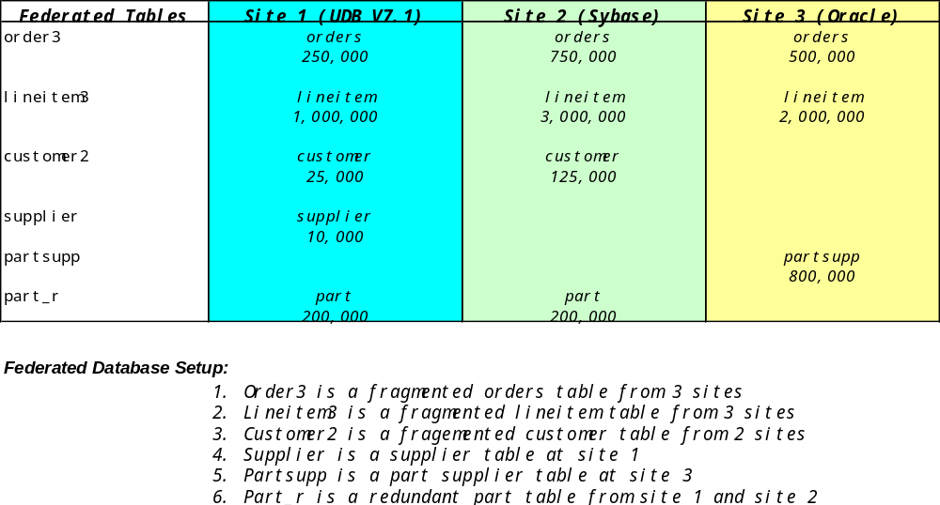
Source Data Distribution

